Slide 1
The Complete Theatre as a Single Robot

Slide 2
The mechanical design concept
Complete automated system of:
  robots,
  controlled cameras,
  controlled furniture, smoke machines, fountains,
  curtains,
  lights and sounds.
More than in standard theatre.
Controlled by a centralized or distributed computer system.
Actors are physical robots with replaceable standard components.
  I could take their heads off.
  I could take their hands off.
  I want to create Lego-like system of components to build robots:
    Lego NXT,
    Tetrix,
    Lynxmotion, etc.
  Connected to internet to acquire knowledge necessary for conversation and behavior
  Use GSP, cameras, gyros, accelerometers and other sophisticated sensors for information acquisition.

Slide 3
Robot Design
The system will be based on components.
From inexpensive to expensive.
  A cheap hand for waving hello
  An expensive hand to grab items.
The robots in the theatre will be seen by a camera and transmitted to world through Internet.
People from outside will be able to control one or more robots and connect the robots to their autonomous or semi-autonomous software.
Various variants of simplified Turing tests will be designed.
No complicated wiring. Just snap-in design with connectors.
  Immediate replacement of a broken hand.

Slide 4
Theory of Robot Theatre?
Motion Theory:
  Motions with symbolic values
Theory of sign
  Creation of scripts, generalized events, motions
  to carry meaning
Robot theories that may be used:
  Machine Learning
  Robot Vision
  Sensor Integration
  Motion: kinematics, inverse kinematics, dynamics
  Group dynamics
  Developmental robots

Slide 5
Types of robot theatre

Slide 6
Realizations of Robot Theatres
Animatronic “Canned” Robot theatre of humanoid robots
  Disneyworld, Disneyland, Pizza Theatre
Theatre of mobile robots with some improvisation
  Ullanta 2000
Theatre of mobile robots and humans
  Hedda Gabler , Broadway, 2008
  Phantom in Opera, 2008
  Switzerland 2009

Slide 7
Animatronic Theatre
Actors: robots
Directors: none
Public: no feedback
Action: fixed
Example: Disney World

Slide 8
Interaction Theatre
Actors: robots
Directors: none
Public: feedback
Action: not fixed
Example: Hahoe

Slide 9
Behavior Learning Architecture for Interaction Theatre
Motion
Machines
Perception Machines
Output text _{i}
Input text from keyboard
Face Detection and Tracking
Output speech _{i}
Face Recognition
Behavior Machine
Output robot motion _{i}
Facial Emotion Recognition
Hand gesture recognition
Output lights _{i}
Sonar, infrared, touch and other sensors
Output special effects _{i}
Robot architecture is a system of three machines: motion machine, perception machine and brain machine
Speech recognition
Output sounds _{i}

Slide 10
Improvisational Theatre
Actors: robots
Directors: humans
Public: no feedback
Action: not fixed
Example: Schrödinger Cat

Slide 11
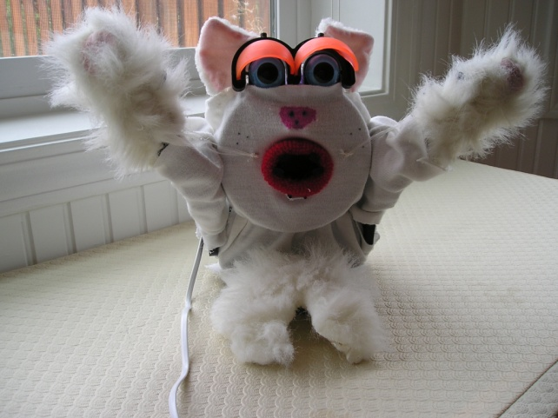
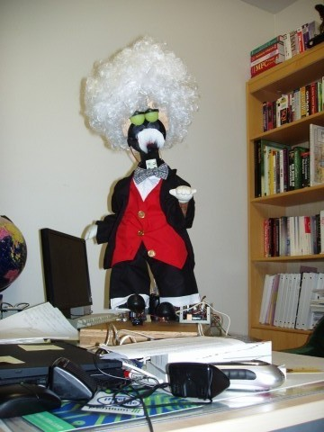
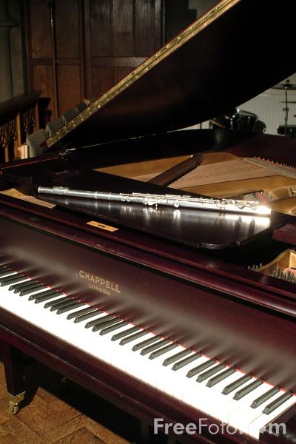
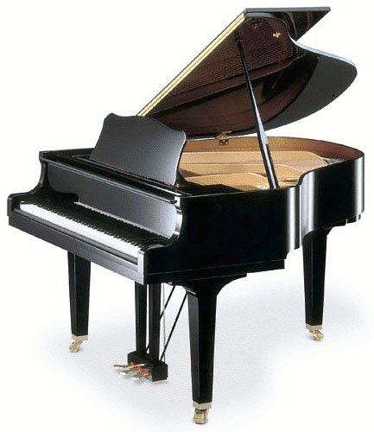
Improvisational Theatre “What’s That? Schrödinger Cat”
Schrödinger Cat
Professor Einstein
Motion _{e1}
Motion _{c1}
Motion _{e2}
Motion _{c1}
Motion _{cm}
Motion _{en}
Motions of Schrödinger Cat
Siddhar
Motions of Einstein
Arushi

Slide 12
Theatre of Robots
and Actors (contemporary)
Actors: robots
Actors: humans
Directors: humans
Public: traditional feedback, works only for human actors
Action: basically fixed, as in standard theatre

Slide 13
Theatre of Robots
and Actors (future)
Actors: robots
Actors: humans
Directors: humans + universal editors
Public: traditional feedback, like clapping, hecking, works for both robot and human actors
Action: improvisational, as in standard improvisational theatre

Slide 14
Motion Machine

Slide 15
controller
Robot
Canned code
Editor
Motion language
motion
controller
Robot

Slide 16
Inverse
Kinematics
Forward
Kinematics
Motion Capture
Editor
Motion language
motion
controller
Robot
Evolutionary Algorithms
A very sophisticated system can be used to create motion but all events are designed off-line.
Some small feedback, internal and external, can be used, for instance to avoid robots bumping to one another, but the robots generally follow the canned script.

Slide 17
Universal Event Editor
Motion Capture
Inverse
Kinematics
Forward
Kinematics
Robots
Events language
Lighting
System
Initial events
Universal Event
Editor
events
controller
Sound System
script
Curtain and all equipment

Slide 18
Universal Editors for Robot Theatre

Slide 19
Universal Perception Editor
Principal Component
Analysis
Neural Nets
cameras
Speech input
Constructive
Induction
Various Feature
Extracting
Methods
Sensors
Clustering
Perception Editor
Examples – input output pairs

Slide 20
Feedback from the environment
controller
Robot
The environment includes:
  Other robots
  Human actors
  Audience
  The director
controller
Robot
Critic

Slide 21
Motion
Motion Problems = examples of correct motions – generalize and modify, interpolate
Mouth Motion
text
Hexapod walking
Distance evaluation
Biped walking
Number of falls
evaluation
Biped Gestures
Comparison to video evaluation
Hand gestures
Subjective human evaluation
Learning problems in Human-Robot Interaction – Motion Generation problems

Slide 22
The concept of generalized motions and universal event editor to edit:
  robot motions,
  behaviors,
  lightings and automated events

Slide 23
Languages to describe all kinds of motions and events
Labanotation
DAP (Disney Animation Principles) and
CRL (Common Robot Language)

Slide 24
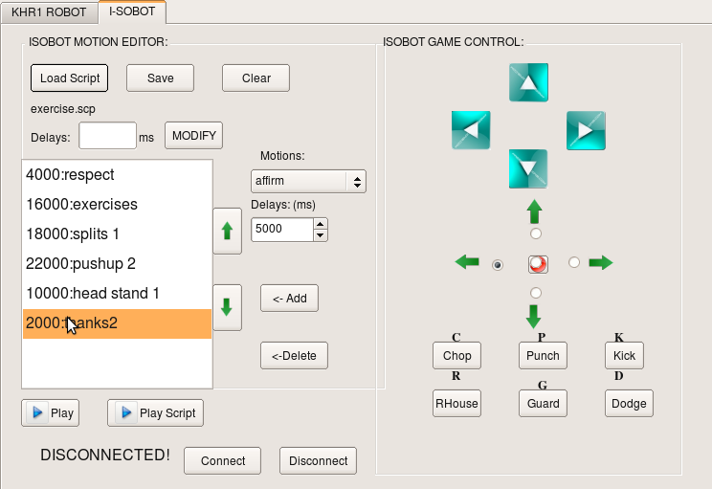
KHR-1 and iSobot Motion Editor Interface

Slide 25
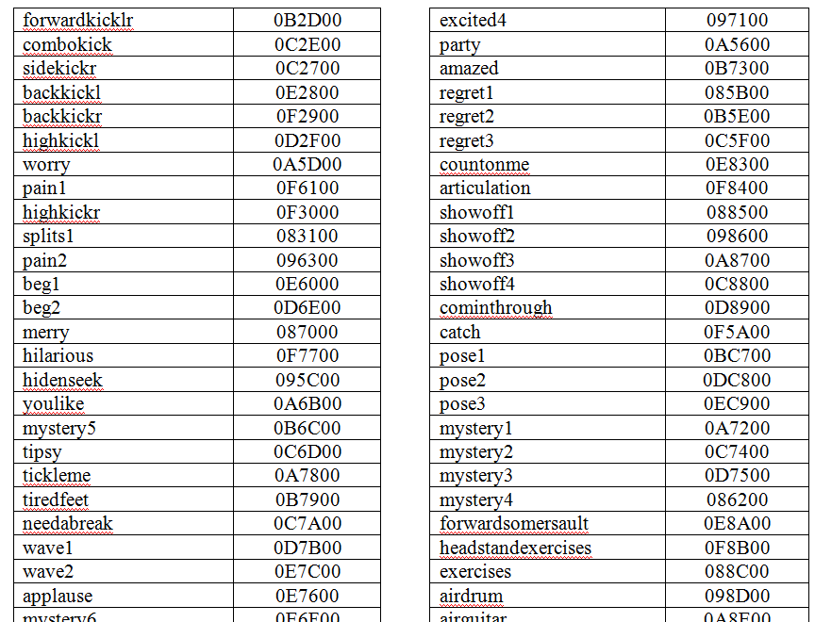
Editor with integrated video, text to speech and probabilistic regular expressions editing

Slide 26
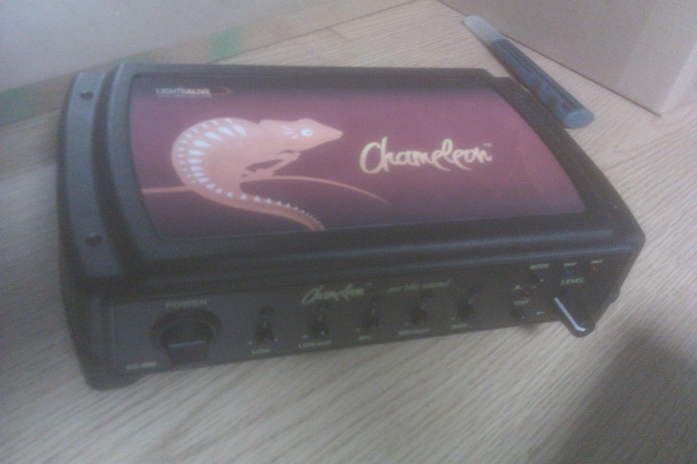
Chameleon box converts sound to light and controls
Sound and effects
Universal
motion editor
MIDI
Lights and controlled events

Slide 27
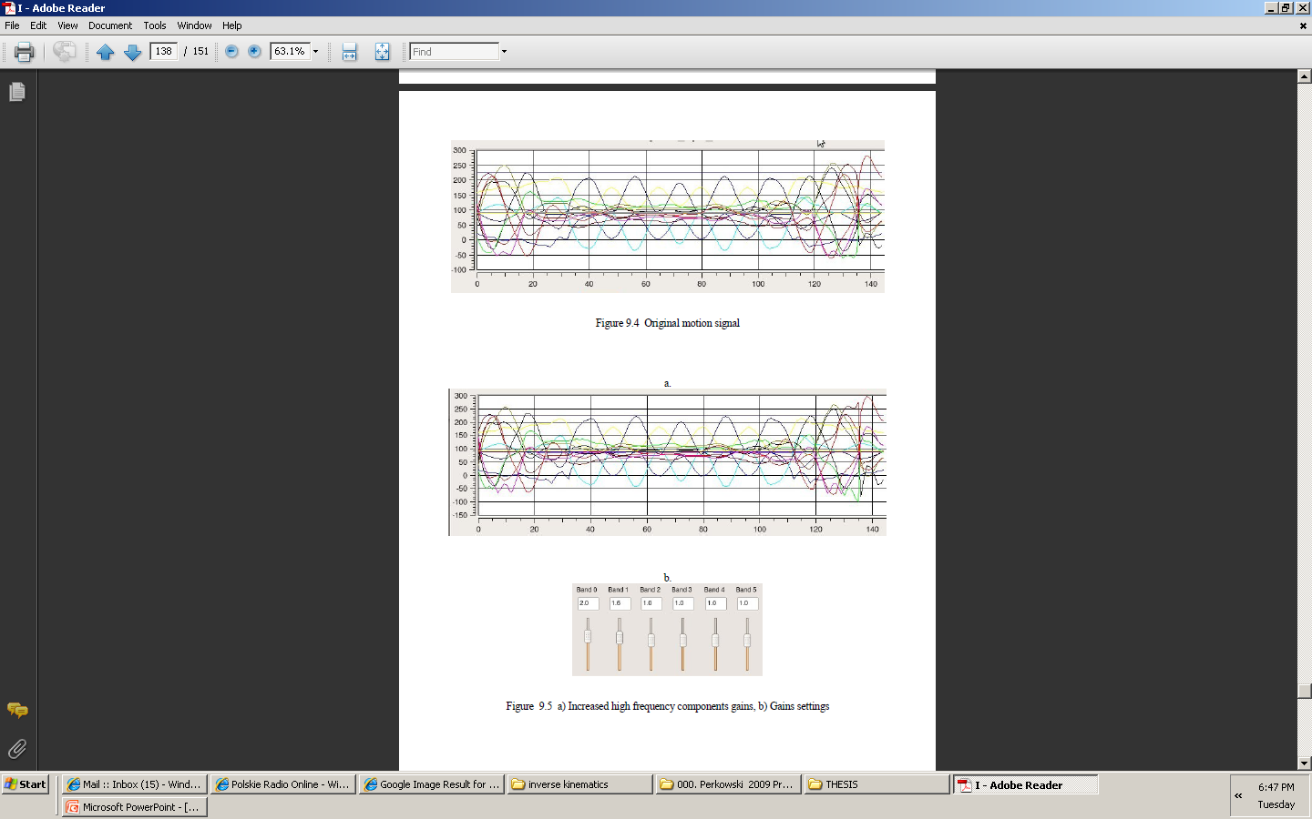
Generating Emotional Motions

Slide 28
Spectral filtering
Matched filters
Hermite interpolation
Spline Interpolation
Wavelets
Repetitions
Mirrors

Slide 29
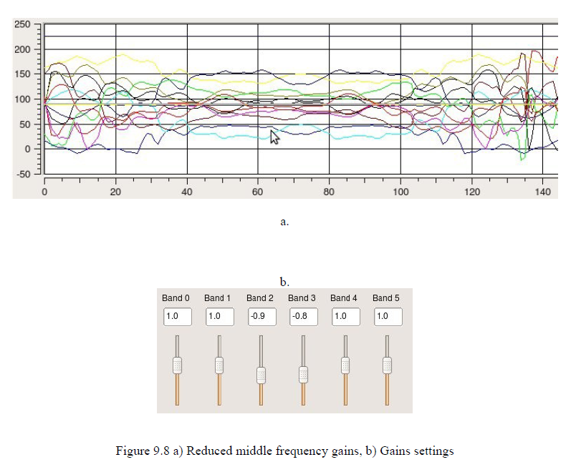

Slide 30
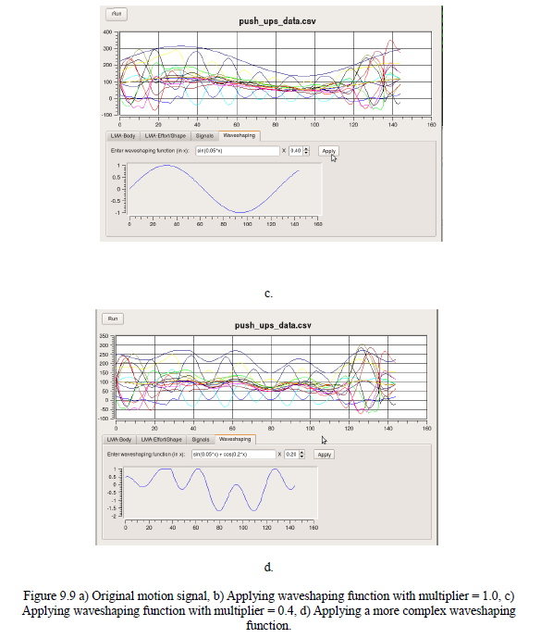
Editor of wwaveforms

Slide 31
Theory of Event Expressions
Reuse concepts from Automata Theory, Quantum Circuits and Bayesian Probability
Tool to design motions directly from symbols.
This theory is general enough to allow arbitrary motion to be symbolically described but is also detailed enough to allow the designer or the robot to precise the generated behavior to the most fundamental details.
Our main concept is that the motion is a sequence of symbols, each symbol corresponding to an elementary action such as shaking head for answering “yes”.
We will call them primitive motions.
The complex motions are created by combining primitive motions.

Slide 32
Greeting_1 = (Wave_Hand_Up º Wave_Hand_Down ) (Wave_Hand_Up º Wave_Hand_Down ) * ∪ Wave_Hand_Up º Say_Hello
Which means, to greet a person the robot should execute one of two actions:
  Action 1: wave hand up, follow it by waving hand down. Execute it at least once.
  Action 2: Wave hand up, next say “Hello”. The same is true for any complex events.
As we see, the semantics of regular expressions is used here, with atomic symbols from the terminal alphabet of basic events {Wave_Hand_Down, Wave_Hand_Up , Say_Hello}.
The operators used here are: concatenation (º), union (∪) and iteration (*). Each operator has one or two arguments.
So far, these expressions are the same as regular expressions.
Initial state
Wave_Hand_Up
Wave_Hand_Up
Wave_Hand_Down
Say_Hello
∈
Wave_Hand_Down
Final state
Wave_Hand_Up

Slide 33
Acceptor, generator and transformer
Observe that this graph can be interpreted as an acceptor, when symbols Xi are inputs.
It can be interpreted as a generator when symbols Xi are outputs.
The graph can be thus used to recognize if some motion belongs to some language and can generate a motion belonging to the language.
This graph is realized in software

Slide 34
Dance, rituality and regularity
Dances of groups of robots are already very popular
In most cases all robots do the same, or there are few groups of robots programmed identically.
It would be interesting to investigate some recursive and iterative patterns, similar to behaviors of flocks of birds and of bees in which emergent behavior can adaptively change one form of regularity to another form of regularity.

Slide 35
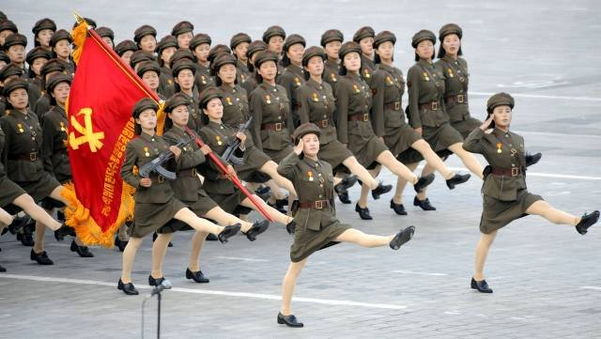
Dance, rituality and regularity
…….change one form of regularity to another form of regularity…….

Slide 36
Conclusions on motion
Motion can be generated based on splines, Spectral methods, regular expressions, grammars, forward and inverse kinematics.
Motion can be transformed from other motions or signals (sound, music, speech, light)
Motion can be acquired (from camera, from accelerometers, body sensors, etc).

Slide 37
Perception Machine

Slide 38
Perception
Face Recognition as a learning problem
Face Image 1
John Smith
Face Image 2
Face Image 3
Marek Perkowski
Face Image 4

Slide 39
Face Emotion (Gesture) Recognition as a learning problem
Face Emotion Recognition as a learning problem
Face Image 1
happy
Face Image 2
Face Image 3
sad
Face Image 4
Face
person

Slide 40
Recognition Problems = Who? What? How?
Face
person
Face
emotion
Face
age
Face
gender
Face
gesture
Learning problems in Human-Robot Interaction – Perception problems

Slide 41
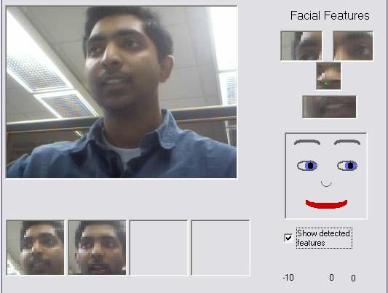
Face features recognition and visualization.

Slide 42
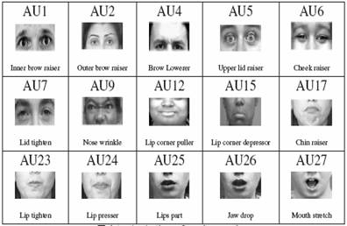
Recognizing Emotions
in Human Face

Slide 43
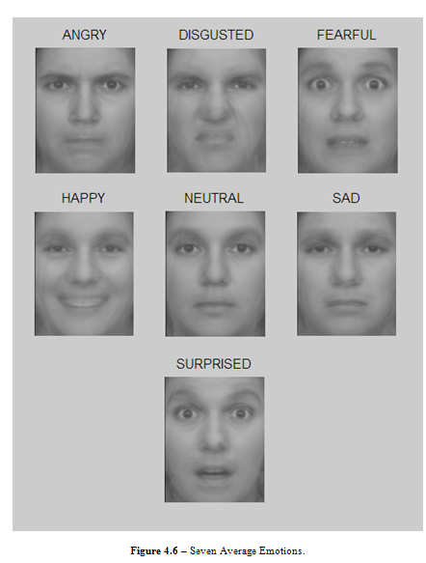
PCA + NN software of Labunsky

Slide 44
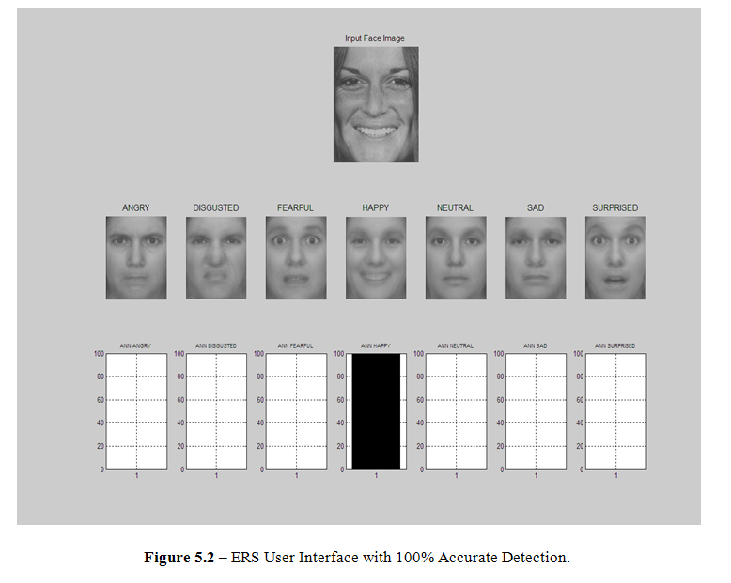

Slide 45
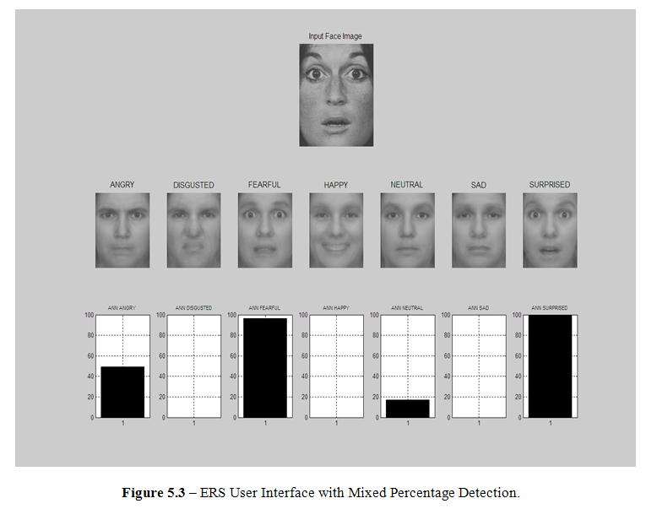

Slide 46
Brain Machine

Slide 47
Software
Artificial and Computational Intelligence:
  Search such as A*.
  Natural language such as integrated chattbots.
  Sophisticated vision and pattern recognition algorithms.
  Evolutionary, Immuno and Neural algorithms.
  Multi-processor systems, multi-threading, CUDA and GPU like systems
  Individual simple behaviors based on hierarchical architectures:
    Distance keeping,
    Tracking.
    Following

Slide 48
Behaviors
Tracking with whole body (mobile robot)
Tracking with upper body of humanoid robot
Keeping distance
Avoiding
Following
Following when far away, avoiding when close
Creating a line of robots
Dancing
Falling down
Standing up
Discussion
Fight

Slide 49
Concepts for brain (implemented and what is wrong with them?)
Genetic algorithm
Genetic programming
Search such as A*
Neural Networks
Predicate Calculus Automatic Theorem Proving
New integrated models of robot:
  Emotional robot
  Quantum robot
  Moral robot

Slide 50
Behaviors
Behavior Problems = examples of correct motions – generalize and modify, interpolate
Input text
Output text
How to evaluate?
Hexapod walking
Distance evaluation
Biped walking
Number of falls
evaluation
Biped Gestures
Comparison to video evaluation
Hand gestures
Subjective human evaluation
Learning problems in Human-Robot Interaction – Motion Behavior (input/output) generation problems

